Slide 1

Basic Details of the Team and Problem Statement
Ministry/Organization Name/Student Innovation:
Indo-Tibetan Border Police (ITBP), MHA
PS Code: 1776
Problem Statement Title: Design and develop an AI-powered operational management system to optimize resource utilization, enhance situational awareness and improve decision-making processes.
Team Name: Argus
Team Leader Name: Arshdeep Kaur
Institute Code (AISHE): U-0564
Institute Name: University of Petroleum and Energy Studies
Theme Name: Smart Automation

Slide 2

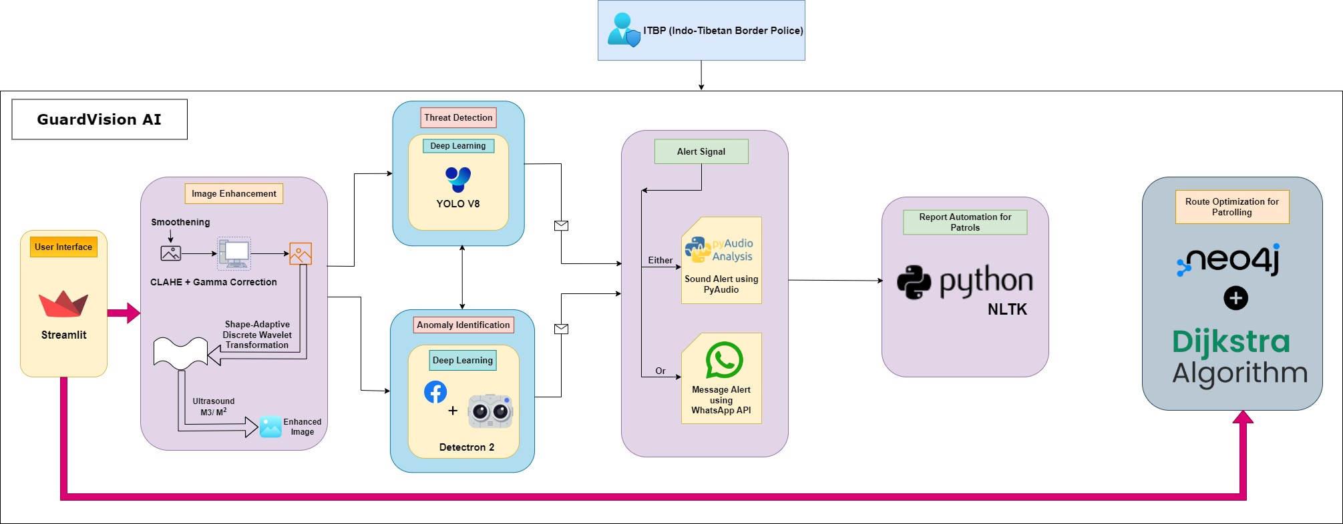
Idea/Approach Details
Describe your idea/Solution/Prototype here:
Enhance border security and operational efficiency along the Indo-Tibetan border using an AI-driven system for real-time threat detection, predictive maintenance, route optimization, and automated reporting.
Real-time data aggregation from surveillance cameras, drones, satellite imagery, and sensors into a unified platform for a comprehensive view of the border situation.
YOLOv8 for fast and accurate Threat Detection (e.g., vehicles, unauthorized personnel).
Detectron2 for Advanced Anomaly Segmentation (e.g., identifying suspicious patterns).
Custom Training on labeled datasets from the Indo-Tibetan border, augmented for varying environmental conditions.
Neo4J Graph Database with Dijkstra’s algorithm for efficient Route Optimization and Dynamic Patrol Adjustments.
Real-time Alerts via PyAudio for verbal notifications and WhatsApp Web API for instant messaging. NLP for generating Automated Incident Reports and summaries, enhancing situational awareness.
Seamless integration with existing ITBP command and control systems.
Describe your Technology stack here:
Object-Detection & Segmentation: Python - YOLO v8, Detectron2(by Facebook).
Data Labelling: Python "LabelMe".
Image Processing: Gamma Correction, CLAHE(Contrast-Limited Adaptive Histogram Equalization) and SA-DWT (Shape Adaptive Discrete Wavelet Transformation) for fusion of images (Python).
Graph Database: Neo4J for Dijkstra's algorithm.
Natural Language Processing (NLP): Automated reporting based on data alerts.
Alerts: PyAudio for real-time sound alerts or WhatsApp Web API for instant messaging.
Frontend: HTML, CSS , Vanilla JS/ React JS/ Angular
Backend: NodeJS, ExpressJS.

Slide 3

Idea/Approach Details
Border Surveillance and Threat Detection:
Leveraging YOLOv8 for real-time detection of unauthorized personnel, vehicles, and drones using live feeds from surveillance cameras and drones along the 3,488 kms Indo-Tibetan border. Detectron2 aids in advanced segmentation to identify suspicious activities or objects. This enables ITBP to rapidly assess and respond to potential security breaches with high accuracy.
Dynamic Patrol Route Optimization:
Utilizing the Neo4J graph database with Dijkstra's algorithm to provide AI-driven, optimized patrol routes. The routes are dynamically adjusted based on real-time data from sensors, surveillance, and environmental factors (terrain, weather), enhancing patrol coverage, safety, and efficiency.
Automated Reporting and Incident Management:
Employing NLP models in Python to automatically generate incident reports and summaries based on real-time data inputs. Alerts are disseminated via PyAudio for verbal notifications or WhatsApp Web API for instant messages, improving situational awareness and decision-making speed for ITBP command centers, leading to faster, coordinated actions.
Describe your Use Cases here
Guarantees seamless operation in isolated and difficult environments, permitting continuous observation and judgement.
Enhances efficiency by evaluating real-time data to optimize patrol routes and making dynamic adjustments in response to shifting circumstances.
Quickly identifies threats, such as unauthorized individuals and vehicles, to guarantee prompt action.
Determines suspicious activity and anomalies with accuracy, improving situational awareness at crucial times.
Slightly reduces the need for manual inputs and streamlines communication by automating issue reporting.
Ensures quick reactions to possible threats and emergencies by sending out immediate alerts to personnels on the ground.
Describe your Dependencies / Show stopper here

Slide 4

Team Member Details
Team Leader Name: Arshdeep Kaur
Branch (Btech/Mtech/PhD etc): B. Tech. Stream (ECE, CSE etc): CSE Year (I,II,III,IV): III
Team Member 1 Name: Sagar Thapliyal
Branch (Btech/Mtech/PhD etc): B. Tech. Stream (ECE, CSE etc): CSE Year (I,II,III,IV): III
Team Member 2 Name: Aviral Khanna
Branch (Btech/Mtech/PhD etc): B. Tech. Stream (ECE, CSE etc): CSE Year (I,II,III,IV): III
Team Member 3 Name: Aryan
Branch (Btech/Mtech/PhD etc): B. Tech. Stream (ECE, CSE etc): CSE Year (I,II,III,IV): III
Team Member 4 Name: Brijanshi Rastogi
Branch (Btech/Mtech/PhD etc): B. Tech. Stream (ECE, CSE etc): CSE Year (I,II,III,IV): III
Team Member 5 Name: Sampurna Roy
Branch (Btech/Mtech/PhD etc): B. Tech. Stream (ECE, CSE etc): CSE Year (I,II,III,IV): III

